Slide 1
SE2001 Software Requirement Engineering (SRE) Fall 2021
Sandia Kumari
Lecture # 13
October 18, 2021

Slide 2
Objectives
To introduce you to a user-centered requirements elicitation method - use cases
To show you the components of the use case model and how you can identify them
To explain the relationship between use cases and scenarios
To explain the need for generalization mechanisms in structuring use cases diagrams

Slide 3
Topics
Identifying actors
Identifying use cases
Internal structure of a use case
Generalization mechanisms

Slide 4
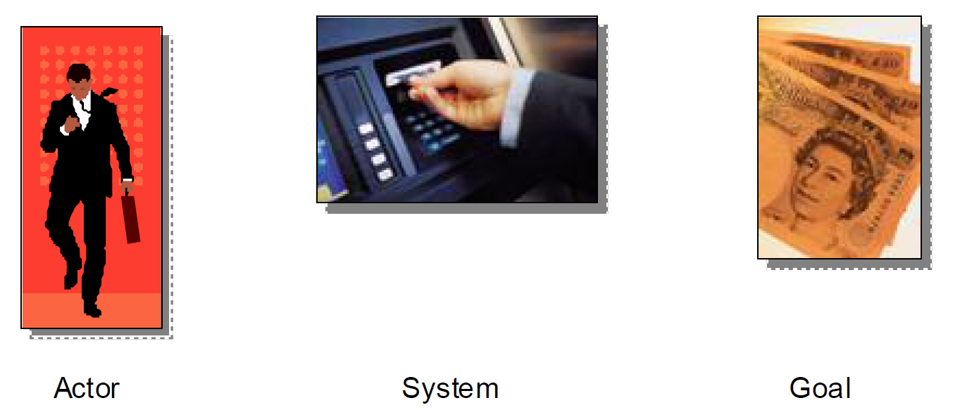
Search on Amazon for books on use cases, and you.ll find hundreds upon hundreds of them. Search on Google for web sites that mention use cases, and you’ll find millions. I don.t think there’s any aspect of software development that’s received wider coverage in the last ten years.
But for all that’s been written about them, most people still don.t really understand them.
This is partly because a lot that’s been written about use cases overcomplicates them and confuses the reader.
a usage case is simply a reason to use a
system. For example, a bank cardholder
might need to use an ATM to get cash out of
their account. It’s as simple as that.

Slide 5
Use Cases
Are an example of user-centered analysis, a methodology for capturing user’s needs (the focus is on what users need to accomplish, in contrast to the traditional elicitation approach of asking users what they want the system to do).
Are a sequence of interactions between the system and one or more actors, in response to some initial stimulus by one of the actors.
Examples of use cases:
installing a database
printing a report
adding a user to the database

Slide 6
There are three key things we need to know to describe a use case:
The actor or actors involved. An actor is a type of user (for example, cardholder) that interacts with the system.
The system being used.
The functional goal that the actor achieves using the system . the reason for using the system.

Slide 7
Little more
The actor describes a role that users play in relation to the system. Maybe the cardholder is an advertising executive, but that doesn.t interest us. We only care what his relationship to the system is.
The actor is external to the system itself.
Actors don’t have to be people. They can be other systems. For example, the ATM may need to connect to the cardholder’s bank. External systems that interact in a use case are also actors.
The goal must be of value to the actor. We wouldn.t have a use case called Cardholder enters PIN. because that, by itself, has no value to the cardholder. We don.t build ATM.s just so people can enter their PINs!

Slide 8
Use Cases
Used in:
requirements
design
testing
user guides
project scheduling

Slide 9
What Is A Use Case Scenario?
When a cardholder tries to withdraw cash from an ATM, it doesn.t always necessarily turn out the same way. Sometimes he gets his money. Other times he might have insufficient funds. Or the ATM may be out of cash. These are all examples of use case scenarios. The outcome is different, depending on circumstances, but they all relate to the same functional goal . that is, they.re all triggered by the same need - and all have the same starting point.

Slide 10
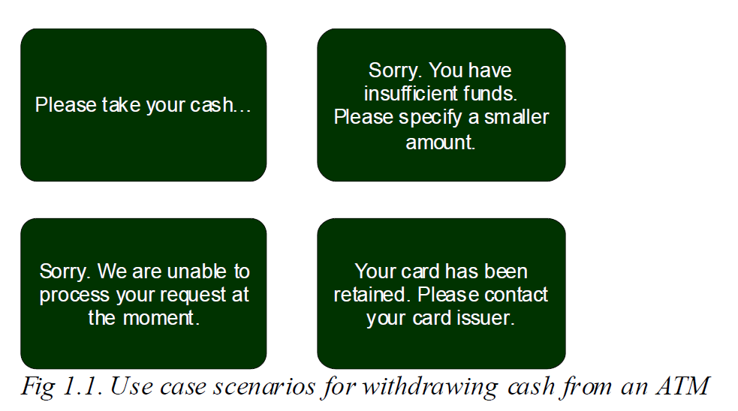

Slide 11
Once we understand the actor and the goal for a use case, and have identified key use case scenarios, we can begin some high-level interaction design. Actors interact with the system by pressing buttons, typing into text boxes, clicking on icons and so forth. To achieve the goal of the use case.

Slide 12
Essential use cases are a great technique for describing interactions in a way that is independent of the technical implementation of the system. Instead of saying the user presses the enter button., we say the user confirms their choice., for example.
A good way to write essential use cases is to split the actions into columns, one for each actor and one for the system. Then we can see at a glance not only the order of events in a use case scenario, but also exactly who is doing what.

Slide 13
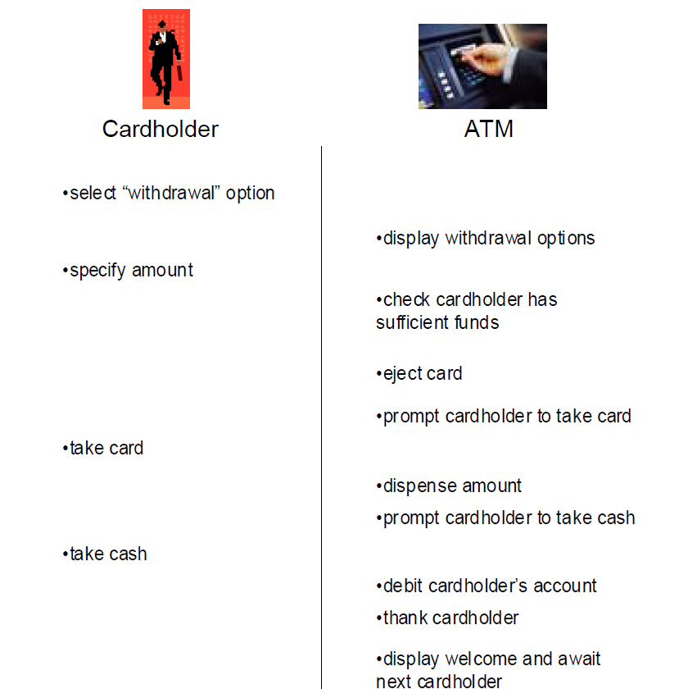

Slide 14
Identifying Actors
Actors are anything that interfaces with the system. Examples: people, software, hardware, other systems.
Each actor defines a particular role
Actors are always external to your system. They are never a part of your system. To help find actors in your system, look for things in the categories of people, other software, hardware devices, data stores, or networks. You also might find it useful to ask questions such as:

Slide 15
Identifying Actors
Each entity outside the system may be represented by 1 or more actors
1 physical person - several actors (several roles) or
several persons - one actor (one role)
Example:
Mary : customer + employee Mary + Bill : customer

Slide 16
Use cases can be used in many processes. Our favorite is a process that is iterative and risk driven. It works well with use cases and object-oriented methodologies.
It helps identify and address risks early in the process, leading to more robust and better quality systems. One commonly used iterative and risk driven process is the Rational Unified Process (RUP).

Slide 17
RUP is divided into four primary phases: inception, elaboration, construction,
and transition.
During the inception phase you will determine the scope of the project
and create a business case for it. At the end of the inception phase you should
be able to answer the question, Does it make good business sense for us to
continue with this project?
During the elaboration phase you will do requirements analysis and risk
analysis, develop a baseline architecture, and create a plan for the construction
phase.
During the construction phase you will progress through a series of
iterations. Each iteration will include analysis, design, implementation, and
testing.
During the transition phase you will complete the things that make what
you developed into a product. These can include beta testing, performance
tuning, and creating additional documentation such as training, user guides,
and sales kits.

Slide 18
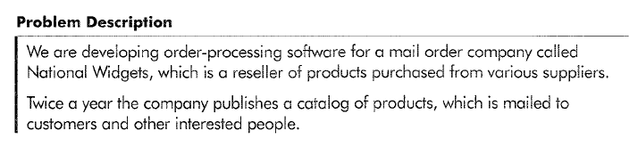
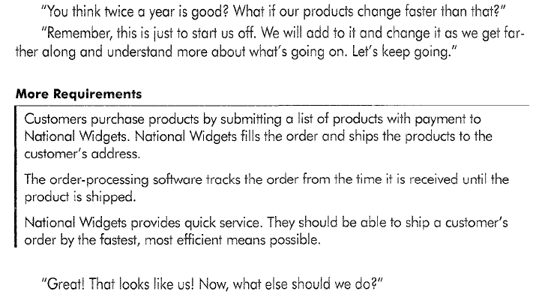

Slide 19
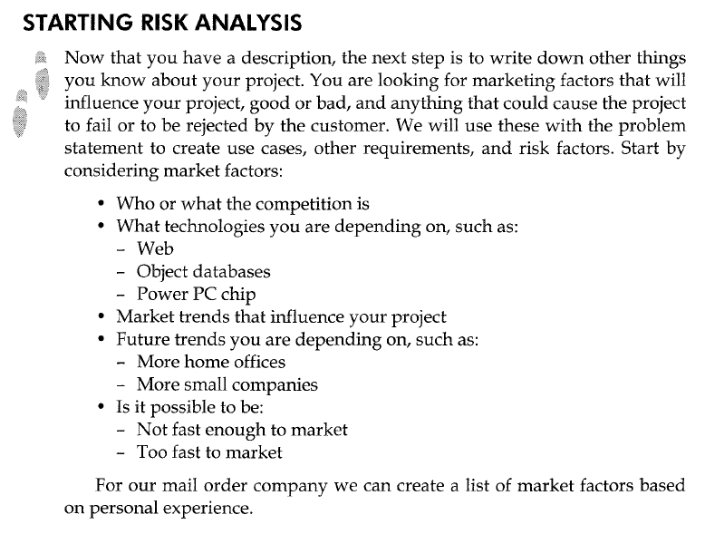

Slide 20
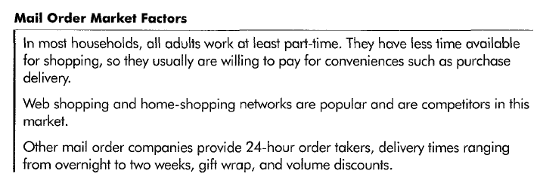
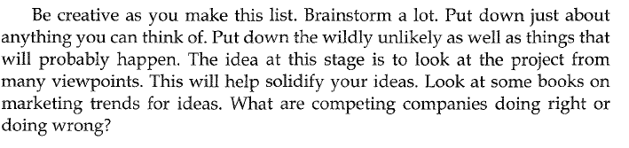

Slide 21
You also need to consider risk factors in your project. You need to include
things that can go wrong. Writing down only the things that you'd like to happen
is a sure recipe for disaster. It is far better to think of how things can go
wrong so you can plan for them than to wander along and be surprised.
You also need to include the possibility of being wildly successful. Sometimes
you'll find that things actually can go wrong if you are too successful.
For example, what would happen to National Widgets if, in the first month,
they get 4,000 calls? They will now have to handle multiple order takers and
large amounts of data. Presuming the company can handle this surge, can the
software handle it? The company could lose business if the software is not up
to the demands placed on it, possibly getting a bad reputation because of it.
Our friends will write this down as one of their risks.

Slide 22
Here are some things to consider as possible risk factors:
People
- Team not experienced
- Team not familiar with the technologies to be used
- Unable to hire people with the right background
System
- Number of transactions per time frame
- Number of expected users
- Expected duration of some functionality
- Legacy systems you have to interface with, such as:
- Software
- Business processes
- Data stores, databases
Resource
- Too short a schedule
- Too many users
- Supplier can't or won't deliver product we depend on
Technology
- Dependence on a technology that changes
Corporate
- Lack of user acceptance
- Too fast company growth

Slide 23
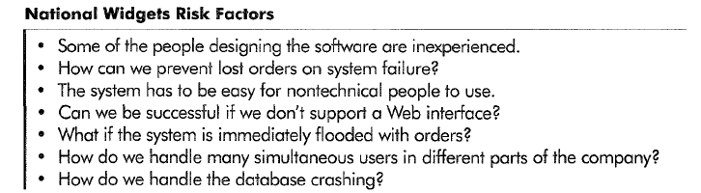

Slide 24
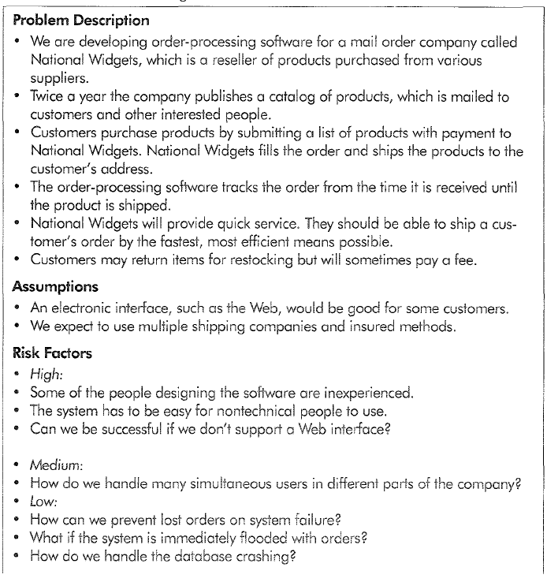

Slide 25
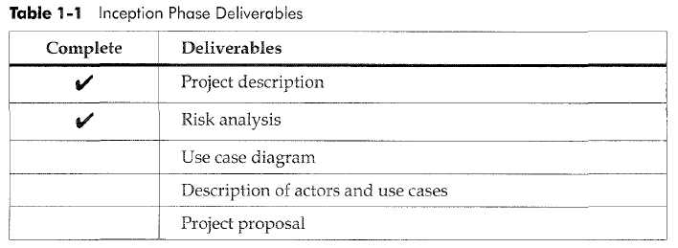
Table shows deliverables you should have completed at this point.
Your risk analysis should include known risks, other known market factors, and assumptions you have made about the project.

Slide 26
Identifying System boundaries
System Boundary Example
What is the boundary of this system?
National Widgets needs to ship orders to customers. Shipping needs to include packaging and labeling orders, weighing them, and determining postage based on shipping method, speed of delivery, insurance, weight, destination, and so on.
Should our order-processing system include calculating postage?

Slide 27
Identifying Actors
Actors are always external to your system. They are never a part of your
system. To help find actors in your system, look for things in the categories of
people, other software, hardware devices, data stores, or networks.
Questions for Identifying actors :
Who uses the system?
Who installs the system?
Who starts up the system?
Who maintains the system?
Who shuts down the system?
What other systems use this system?
Who gets the information from this system?
Who provides information to the system?
Does anything happen automatically at a present time?

Slide 28
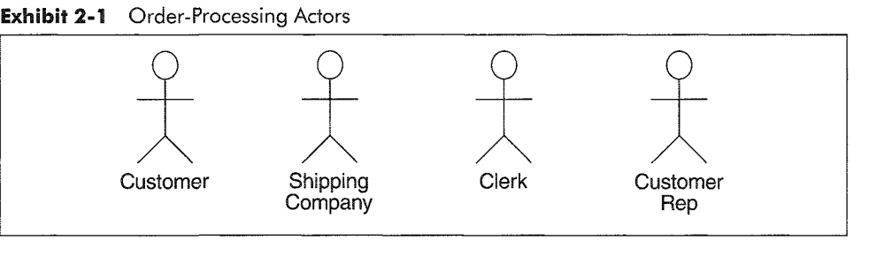

Slide 29
Class exercise
Identify the actors for a food order system.

Slide 30
Identifying use cases
Use cases describe the system functionalities
The name of the use case states the user task in the form “verb + object”
A use case is always started by an actor, unless it is triggered by a change in the system’s state
A use case is not a single scenario
Go through all of the actors and identify use cases for each one

Slide 31
Identifying use cases (cont.)
Examples:
What functions will the actor want from the system?
•Does the system store information? What actors will create, read, update, or delete that information?
Does the system need to notify an actor about changes in its internal state?
Are there any external events that the system must know about? What actor informs the system about those events?

Slide 32
Other kinds of use cases to consider are startup, shutdown, diagnostics, installation, training, and changing a business process. A common one that many people forget is maintenance. How are you going to repair the system?

Slide 33
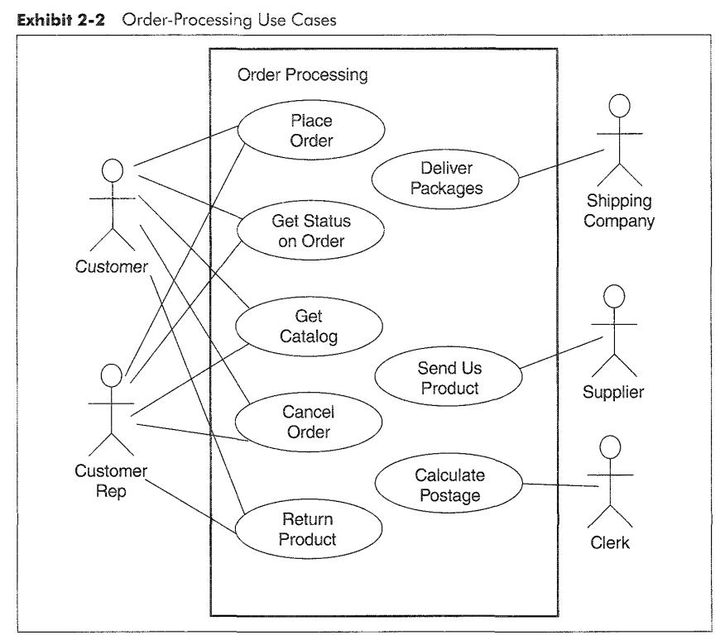
Use case diagram

Slide 34
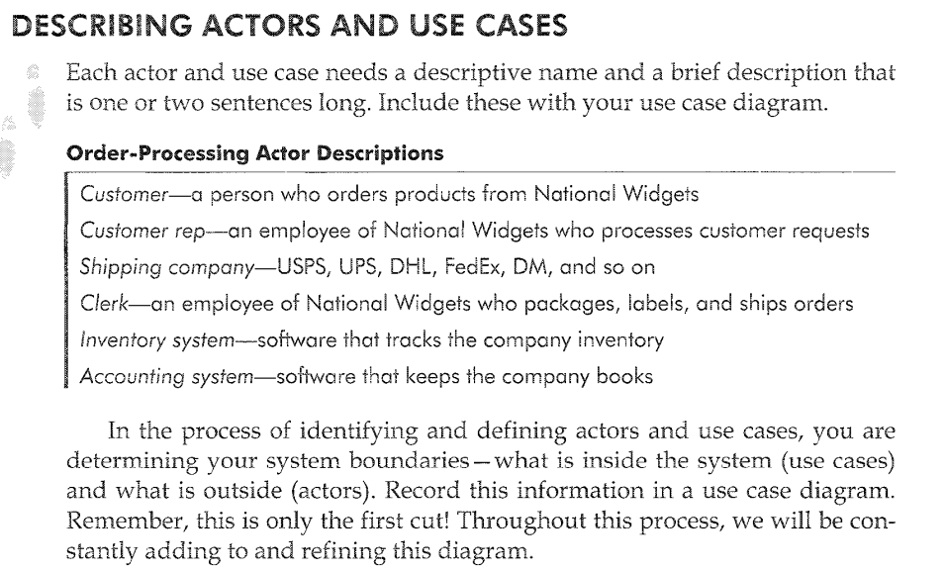

Slide 35
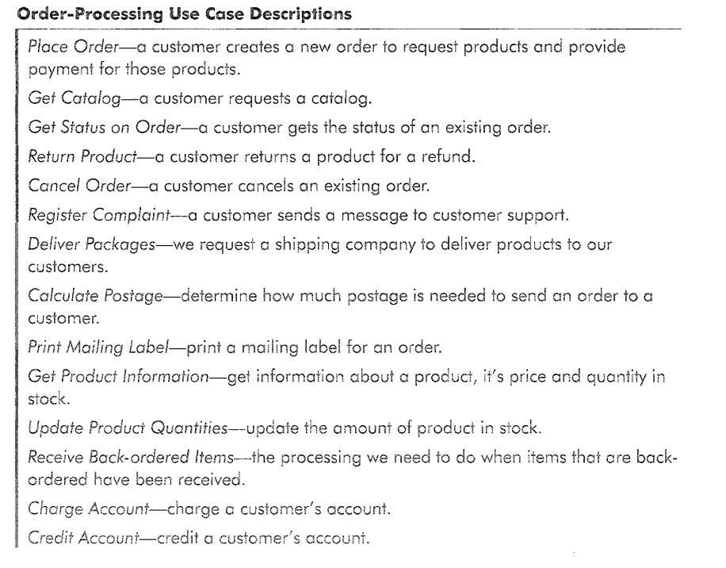

Slide 36
Class exercise
Identify the use cases for the food order system.
Draw the use case diagram
Find the boundaries of the system:
what things are inside your system (you need to create them) and
what things are outside your system (you don’t need to create them, but you need to interface with them)

Slide 37
Use cases - Internal structure
Precondition
Flow of events
basic path
alternative paths
Post condition
must be true no matter which branch or alternative is followed for the use case
Special requirements

Slide 38
Use Case Example
Withdraw Money Use Case
Introduction
Withdraw Money lets a bank Customer withdraw money from an ATM.
Precondition: A valid Customer is identified.
Flow of Events:
1. The use case starts when the Customer selects Withdraw Money.
2. The Customer chooses how much to withdraw and from which account.
3. The system responds with how much can be withdrawn from that account.
4. The system dispenses the amount.
5. The system deducts the amount from the account and the use case ends.

Slide 39
Use Case Example
Alternative Paths:
In step 5, if the deduction results in an overdraft, it is handled accordingly to {Account Overdrawn}.
Postcondition: The transaction has been recorded in the system.
Special requirements:
The following are maximum response times as the system:
verifies the identity of the Bank Customer
presents the balance of Account that the Bank Customer has chosen
dispenses the amount and deducts the amount from the Account.
Whenever the server does not respond within 5 seconds, the client considers the server to be down and cancels the use case.
There may be no more than 100 instances of the use case Withdraw Money executing in parallel on this server.

Slide 40
Flow of events
Alternative paths stated either
as if statement in the basic path or
in the alternative paths section
Use explicit repetition constructs for and while to repeat a step or multiple steps

Slide 41
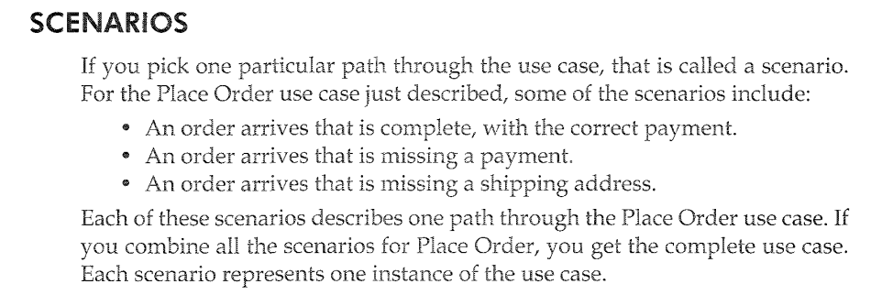

Slide 42
Scenarios
Describe one path through the use case (an instance) Example:
an order that is complete, with the correct payment arrives
an order that is missing a payment arrives
Primary scenarios - the basic use case functionality
Secondary scenarios - alternatives + error conditions

Slide 43
Primary scenarios
Written as if everything goes right: no errors, no branching or alternatives
Written from the actor’s point of view
Start by indicating who begins the scenario and how
Continue listing steps
Finish by indicating how the scenario ends
Update the list of actors and use cases

Slide 44
Primary scenarios (cont.)
The steps will be ordered by time
If the steps can run concurrently, make it clear in the beginning of the scenario
NFRs
can be included either in a “Special Requirements” section of the use case OR
in an “Other requirements” document

Slide 45
Use cases can be written very formally or in a less formal style. Keep in mind
who will be reading the use cases and choose a style that is comfortable for
the readers. Potential readers of use cases include end users, customers, marketing
specialists, customer advisory boards, users groups, testers, technical
writers, system architects, system engineers, several levels of management,
and developers.

Slide 46
Primary scenarios (cont.)
Presentation styles:
informal
numbered sequence of steps
Pseudocode
- UML activity diagrams

Slide 47
Informal Text Form of Use Case
Cancel Order use case s
When the customer rep receives a request to cancel an order, the customer rep finds the order in the system and marks it canceled. Then a request is sent to the accounting system to credit the customer’s account.

Slide 48
Numbered Sequence of Steps Cancel Order use case
1. The use case begins when the customer rep receives a request to cancel an order.
2. The customer rep enters an order ID.
3. The customer rep presses “Find” to find the order in the system.
4. The system will display that order.
5. The system marks the order canceled.
6. The accounting system is notified to credit the customer’s account and the use case ends.

Slide 49
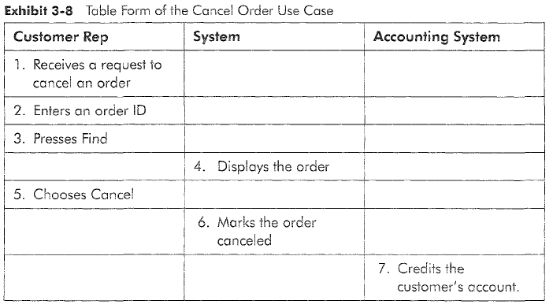

Slide 50
Pseudocode Form of Use Case Cancel Order use case
Order = Customer.CancelOrder (OrderNumber)
Order. Status = canceled
Accounting.SendRefund (Customer, Order. Amount)

Slide 51
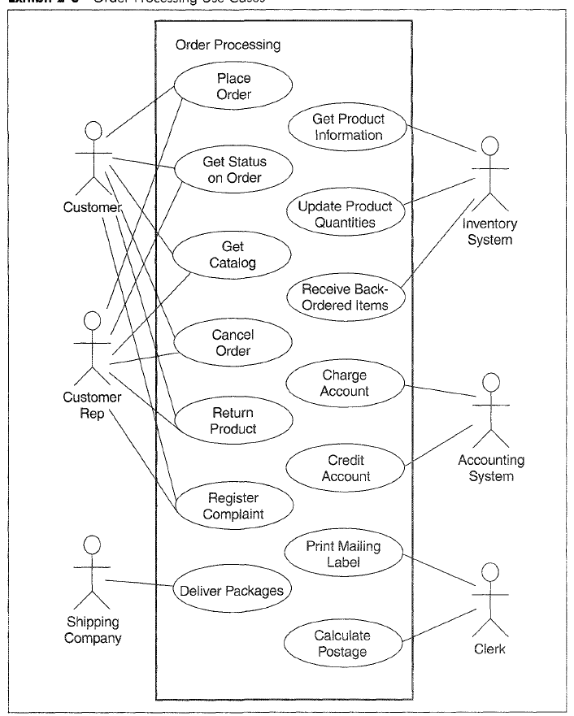

Slide 52
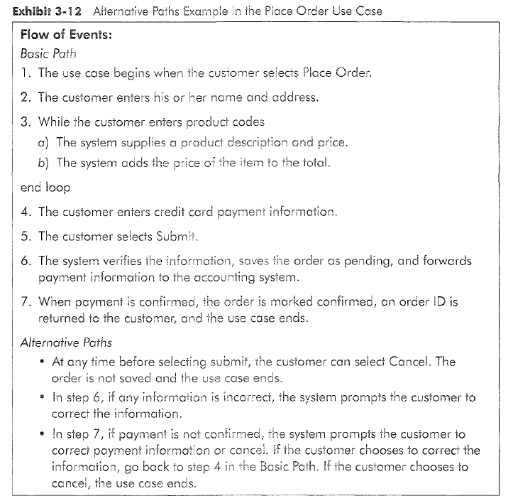

Slide 53
Activity Diagram Example – Place Order Use case
Log In
Submit
[Place order selected]
[info complete]
Order Form
Displayed
Order Marked
Pending
Enter Name
and Address
Payment Information
Sent to Accounting
[Product code entered]
[payment good]
Product Description
and Price Displayed
Order Marked
Confirmed
[product code
entered]
New Total
Calculated
Order ID
Displayed
[No more product codes]
Enter Credit
Card Information

Slide 54
Secondary Scenarios
Alternative scenarios
Exception scenarios
Documentation styles:
include the alternative/exceptions in either of these choices:
the basic path of a primary scenario
the alternative path section
separate secondary scenarios

Slide 55
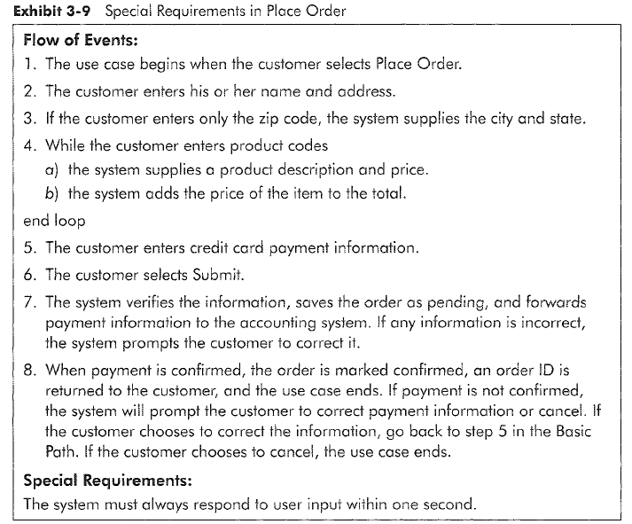

Slide 56
Exercises
Class exercise: Write a primary and a secondary scenario for the mail order system
Group exercise: write a primary and a secondary scenario for the automated library system.

Slide 57
Generalization mechanisms
<<Extends>>
[amount to be withdrawn > balance]
Extends
Includes
Inheritance between actors, use cases
Interfaces for actors, use cases
Withdraw
Money
Overdraft
Management
Withdraw
Money
Deposit
Money
Transfer Between
Accounts
<<includes>>
Validate User

Slide 58
Inheritance Relationships
Between actors or between use cases
Inheritance between Actors:
An actor fills the same roles as another actor, and some other additional roles
It interacts with the same use cases in the same way, therefore we can simplify the use case diagram by using this inheritance relationship

Slide 59
In the use case diagram, inheritance can be used between actors or use cases.
Inheritance is a "kind-of" relationship, where one element is a kind of the
other element. Inheritance between actors means that one actor fills the same roles as another actor. It also may fill additional roles. It interacts with the same uses cases in the same way. Inheritance between use cases means one use case is a specialized version of another use case.
The specialized use case inherits behavior from the general use case and may add to it. In the UML, inheritance is indicated by a generalization relationship.

Slide 60
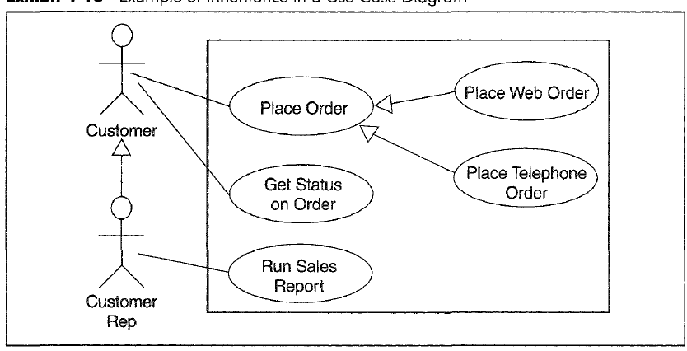

Slide 61
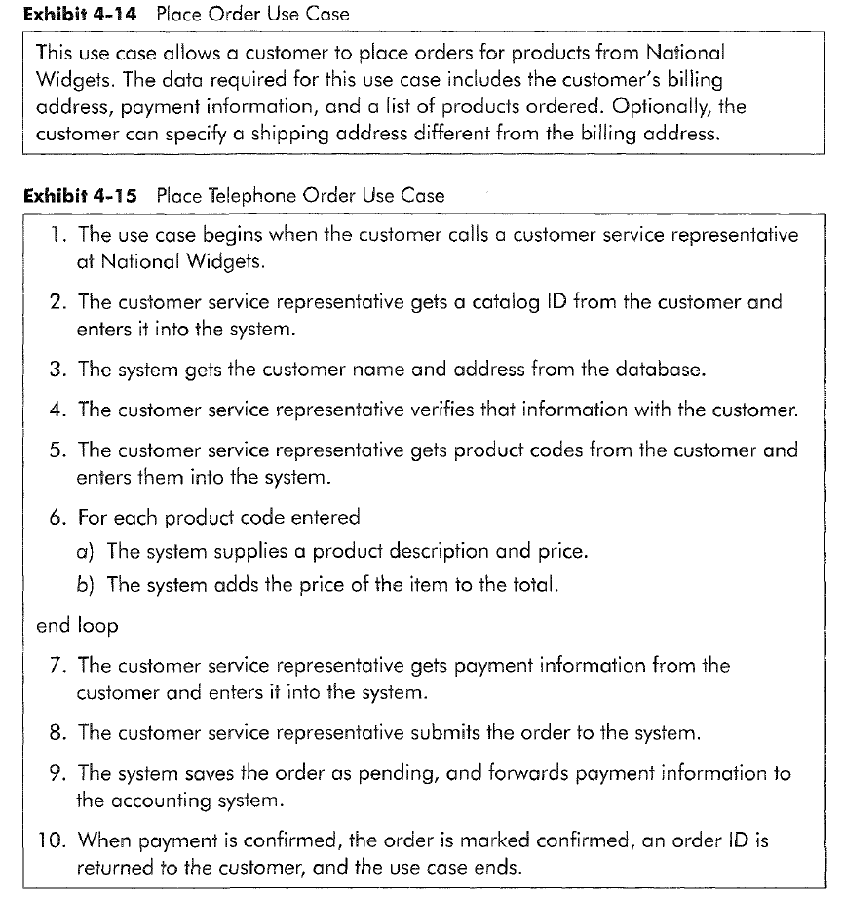

Slide 62
If you find yourself cutting and pasting the same block of text over and over, it indicates you have something generic you can reuse.
You can abstract the common behavior with an include relationship. Start out by identifying the steps that you want to use in many places. Put the steps in a use case and give them a name.

Slide 63
Includes Relationships
Abstracts the common behavior from several use cases
The common behavior is introduced by the Include keyword
Can have as many levels of include as you need
No limit on the number of use cases that can be “included”
Cancel Order includes Search Order

Slide 64
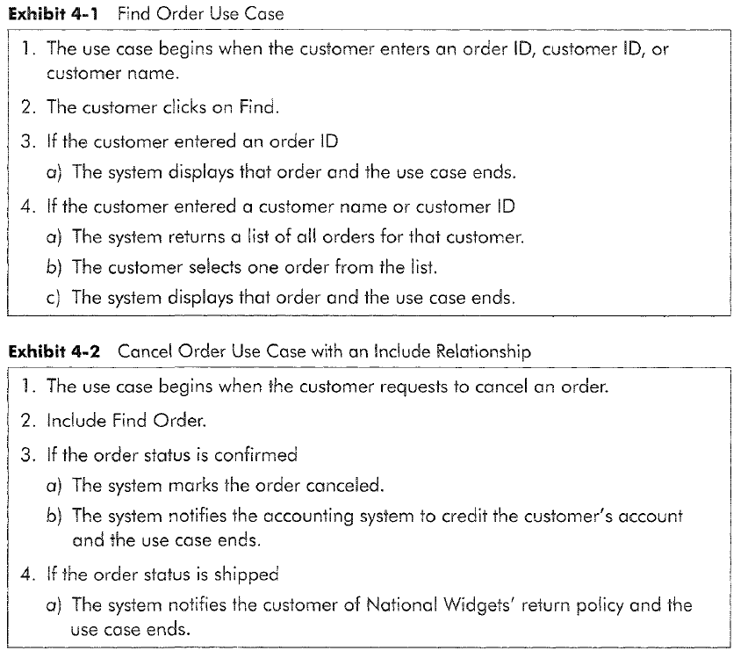

Slide 65
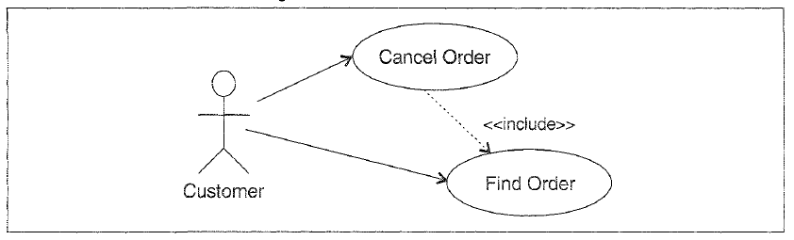

Slide 66
Extend is used to conditionally extend the behavior of an existing use case.
It's a way of adding behavior to a use case without changing the original use case. We typically use extend when working on a later version of an existing product or to indicate places where a product can be customized.

Slide 67
Extends Relationships
Useful for changes and additions to an existing use case
When you have an optional sequence of events you want to add to a use case – for customizing a product, or when working on a later version of an existing product
Start by determining what you want to add and where in the use case that needs to be modified
The use case being extended does not change
Update the use case diagram to include extension points, and the conditional expression that would trigger the extending use case
Write a use case describing what will happen at the extension point (the extending use case)

Slide 68
Extends Relationships
Can have more extensions from one point. The order of execution is undefined.
Exercise: Write an extending use case for the Place Order Use Case. The extending use case should calculate the product price when a product is on sale.

Slide 69
Inheritance between Actors-Example
Withdraw money
Deposit money
Bank
Customer
Loan for purchasing
other companies
Private
Customer
Corporate
Customer

Slide 70
Examples of Inheritance in a Use Case Diagram
Place Order
Place Web Order
Customer
Get Status on Order
Place Telephone Order
Run Sales on Order
Customer Rep

Slide 71
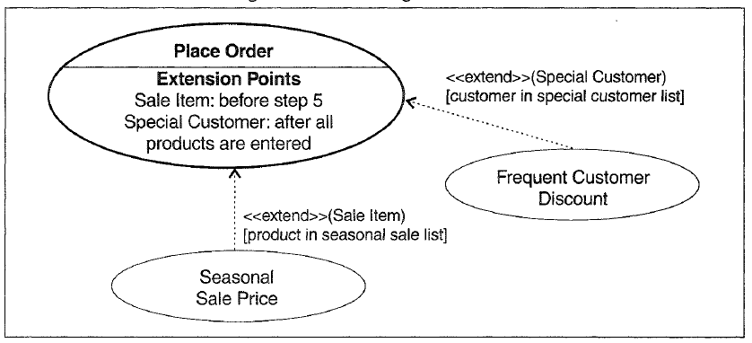

Slide 72
Place Order Use Case
The use case begins when the customer selects Place Order
The customer enters his or her name and address
If the customer enters only the zip code, the system supplies the city and state.
The customer enters product codes for products to be ordered.
For each product code entered
The system supplies a product description
The system supplies a product price
The system adds the price of the item to the total
end loop
The customer enters credit card payment information
The customer selects Submit
The system verifies the information, saves the order as pending, and forwards payment information to the accounting system.
When payment is confirmed, the order is marked confirmed, an order ID is returned to the customer, and the use case ends.

Slide 73
Inheritance Relationship (cont.)
Inheritance between Use cases
One use case is a specialized version of another use case
Can be documented in two ways:
The parent use case is just a description, while the specialized use cases contain the detailed flow of events.
The parent use case is written as a complete flow of events. The specialized use cases just describe how they are different from the parent use case.

Slide 74
Use Cases Level of Detail
Determine who needs the use case and how it will be used.
It may be used by managers, end users, or developers (see next slides for examples of each category of users and the difference in the level of detail of use cases).

Slide 75
Business Process Use case
The use case begins when the customer places an order for products with the customer service department.
The customer service department sends the payment information for the order to the accounting department
The accounting department updates National Widgets’ accounts and deposits the payments in the bank.
The customer service department sends the order to the warehouse department
The warehouse department collects the items for the order and sends them with the shipping address to the shipping department
The shipping department packages up the items with the shipping address and gives the package to a shipping company for delivery to the customer, and use case ends.

Slide 76
Place Order Use case – Actor View
The use case begins when the customer selects Place Order
The customer enters his or her name and address
If the customer enters only the zip code, the system supplies the city and state.
The customer enters product codes for products to be ordered.
For each product code entered
The system supplies a product description and price
The system adds the price of the item to the totalend loop
The customer enters credit card payment information
The customer selects Submit
The system verifies the information, saves the order as pending, and forwards payment information to the accounting system.
When payment is confirmed, the order is marked confirmed, an order ID is returned to the customer, and the use case ends.

Slide 77
Place Order Use case – Developer View
The use case begins when the customer selects Place Order
The customer enters his or her name and address
If the customer enters only the zip code, the system uses the zip code to query the U.S. Post Office online repository to get the city and state, the system adds the city and state to the order
The customer enters product codes for products to be ordered
For each product code entered
The system uses the product code to query the inventory system software for a product description and price. The system adds the description and price to the order. The system queries the customer for product quantity. The customer enters a quantity for the product.
The system adds the price of the item to the subtotal of the order

Slide 78
Place Order Use case – Developer View (cont.)
The customer enters credit card payment information
The customer selects Submit
The system makes sure that all necessary data is entered, which must include a complete shipping address, credit card payment information, and at least one product. The system saves the order as pending and forwards payment information and the subtotal to the accounting system.
The accounting system calculates the tax and shipping amounts and returns a total for the order along with an indication of success in accepting the payment. The system marks the order confirmed, returns the total and an order ID to the customer, and the use case ends.

Slide 79
Use cases traps to avoid
Too many uses cases – you might not be writing them at the appropriate level of abstraction
Highly complex use cases – they might become incomprehensible
Including user interface design in the use cases – Defer user interface specifics to the design stage. Say “system presents choices” instead of “system displays drop-down list”
Including data definitions in the use cases – include them instead in the project’s data dictionary.

Slide 80
Summary
Use cases are a method of capturing users needs in a user-centered approach
Actors are anything that interfaces with the system
Use cases are a sequence of interactions between the system and one or more actors, in response to some initial stimulus by one of the actors
A use case is not a single scenario
A use case is organized as preconditions, flow of events and postconditions
A use case contains one primary scenario and optionally, secondary scenarios
Use cases can be structured using generalization mechanisms such as includes, extends, inheritance

